Slide 1
Introduction to Measuring Tools
Rice Air Curriculum
Teacher Training

Slide 2
Measurement Overview
Students will use GLOBE-certified instruments to take the measurements on Days 2-6
Students record data on data sheets
If possible, find a bench or table in an open area outside (>30 feet from nearest building) to serve as a measurement station
Measurements should be taken in the same place every day

Slide 3
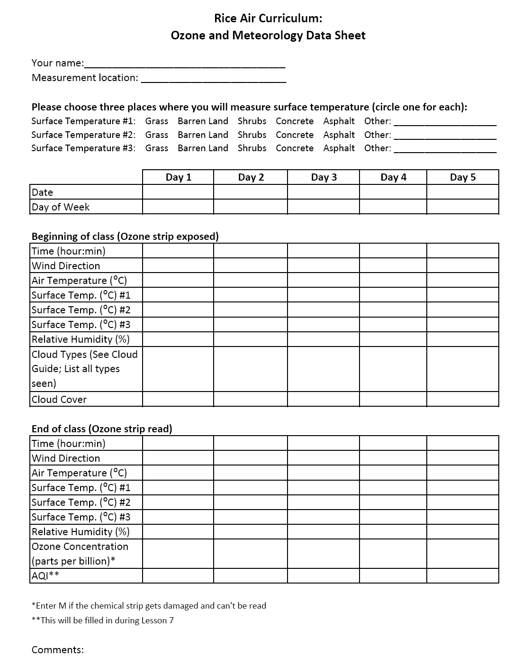

Slide 4
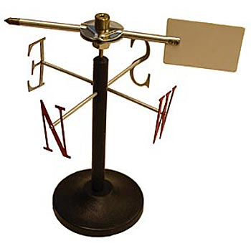
Wind Vane
Place pointer on wind vane base
Place wind vane on station, using compass to align North
The pointer points in the direction where the wind is coming from
Note: A “north wind” is a wind that blows from the north

Slide 5
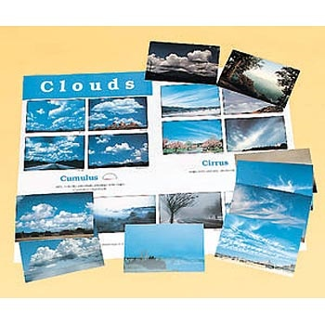
Cloud Charts
Teach students how to recognize different types of clouds
Posters and flashcards included
101 suggested activities – coded by age-level appropriateness

Slide 6
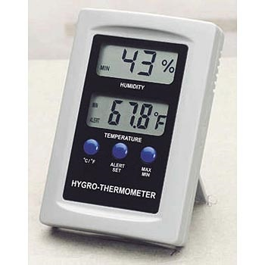
Hygrometer
(Air Temperature and Relative Humidity)
Place instrument on station
Use C/F button to choose Celsius or Fahrenheit
Record air temperature and relative humidity at the beginning and end of the measurement period
Protect instrument by storing it in a dry place and not using it on wet days

Slide 7
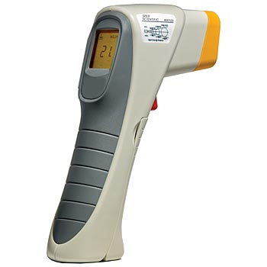
Infrared Thermometer Gun
(Surface Temperature)
Wrap instrument in thermal glove (oven mitt cut with opening for front of device), OR equilibrate outside for 30 minutes
Students choose 3 places for surface temperature measurements (e.g., grassy area, concrete area)
Students point the instrument at the surface, pull the trigger, and record the temperature from the display
  Caution: Remind students not to point the laser at anyone

Slide 8
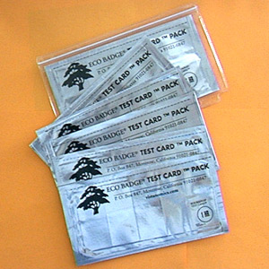
Ozone Strips (Eco Badge Test Cards)
Chemically sensitive strips that change color in presence of ozone
Keep strips in a closed plastic pouch prior to use. Once the strip is exposed, it begins to react with any ozone that is present.
Expose strip to freely moving outside air for 1 hour; Hold in place on station with clothespin or clip
Avoid touching the chemical on the strip; doing so is not hazardous, but impairs the measurement
Read the strip in the field by using the ozone scanner

Slide 9
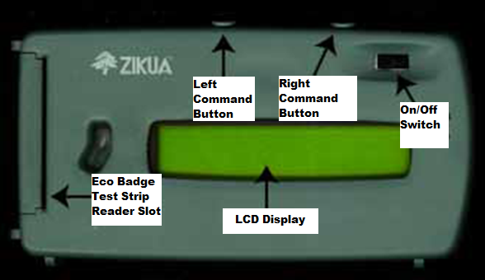
Zikua Ozone Scanner
  Optical reader that measures ozone concentrations from strips
Components:
  LCD display
  On/off switch
  Two command buttons
    Left button for scrolling
    Right button for selecting values
  Slot on the left side to insert Eco Badge ® Test Card
  Screen brightness adjustment screw on back of unit
Credit: Vistanomics

Slide 10
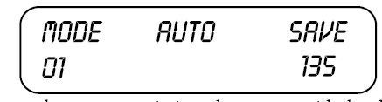
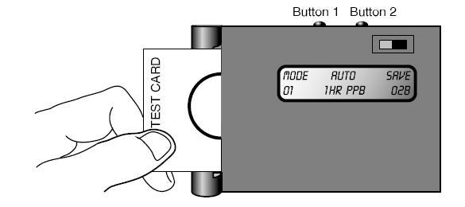
Calibrating the Zikua
Calibrating the Zikua uses an unexposed card to establish a baseline standard for reading exposed Test Cards.
Calibration should be performed each time you begin a new series of Zikua readings and then every 15-20 tests.
Turn on the scanner away from direct sunlight.
2. Insert an unexposed one hour Test Card into the Zikua’s Test Card slot. The printed side of the Card should face the LCD display. The number in the lower right of the LCD will change.

Slide 11


Calibration (continued)
3. Press the left button repeatedly from the Settings display to Select the Calibration command (LCD screen below).
4. Press the right button. LCD shows “1 HR WHT = “(# may vary)
5. Press the left and right buttons at the same time to save your calibration. Turn off the scanner, and remove the unexposed Test Card from the slot. The Zikua is now ready to read exposed Test Cards.

Slide 12



Choosing Settings
1. Press the left button until the LCD shows the Settings command:
2. Press the right button to specify the Settings command. Press the right button repeatedly to scroll through duration options. You want to choose 1 HOUR.
3. When the test duration you want to use is displayed, press the left button. Press the right button repeatedly to scroll through measurement options. Select PPB (Parts per billion).
4. Press the left and right buttons simultaneously to save settings

Slide 13
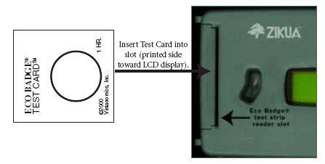
Reading the Exposed Test Cards
Place the scanner on a flat surface in a shaded area, letting it adjust to outside conditions. Turn it on and let it run for at least 30 seconds. It should say MODE 01, AUTO 1 HR PPB. If not, adjust MODE by scrolling with left button to “RESET”; see previous slide to adjust the units.
2. Insert an exposed Test Card (printed side facing LCD) into Test Card slot.
3. The ozone concentration is the number in the lower right of the LCD. Record the number after the fluctuations have subsided, or the smaller number if fluctuations continue.

Slide 14
Measurement Logistics
Take measurements at consistent time each day
  Could compare results across classrooms measuring at different times
Meteorology measurements are taken at beginning and end of hour
Ozone strip is placed at start of period, exposed for one hour, and then measured with scanner
Need a plan for how students will work in teams

Slide 15
Reminders
Full descriptions of all the GLOBE measurement protocols are available on Connexions or at www.globe.gov
Student Safety:
  Remind students to not directly look into the sun when observing the weather
  Remind students to not point the laser of the Infrared Thermometer at anyone

Slide 16
Questions?

